Slide 1
Mark 2:23– 3:6

Slide 2
²³ One Sabbath he was going through the grainfields, and as they made their way, his disciples began to pluck heads of grain. ²⁴ And the Pharisees were saying to him, “Look, why are they doing what is not lawful on the Sabbath?” ²⁵ And he said to them, “Have you never read what David did, when he was in need and was hungry, he and those who were with him: ²⁶ how he entered the house of God, in the time of Abiathar the high priest, and ate the bread of the Presence, which it is not lawful for any but the priests to eat, and also gave it to those who were with him?” ²⁷ And he said to them, “The Sabbath was made for man, not man for the Sabbath. ²⁸ So the Son of Man is lord even of the Sabbath.”

Slide 3
3 Again he entered the synagogue, and a man was there with a withered hand. ² And they watched Jesus, to see whether he would heal him on the Sabbath, so that they might accuse him. ³ And he said to the man with the withered hand, “Come here.” ⁴ And he said to them, “Is it lawful on the Sabbath to do good or to do harm, to save life or to kill?” But they were silent. ⁵ And he looked around at them with anger, grieved at their hardness of heart, and said to the man, “Stretch out your hand.” He stretched it out, and his hand was restored. ⁶ The Pharisees went out and immediately held counsel with the Herodians against him, how to destroy him.

Slide 4
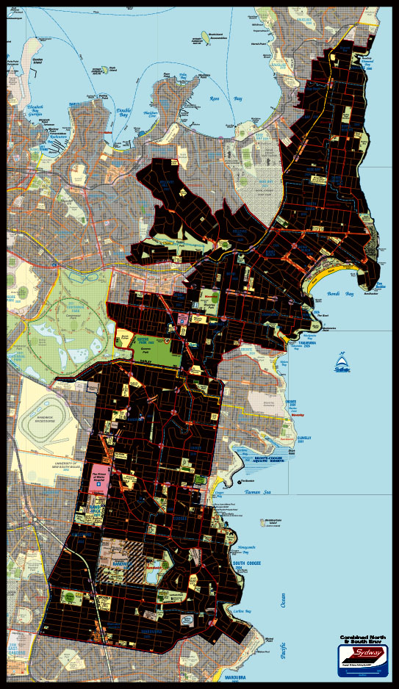
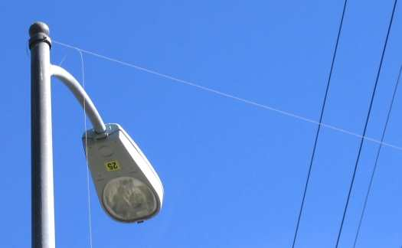
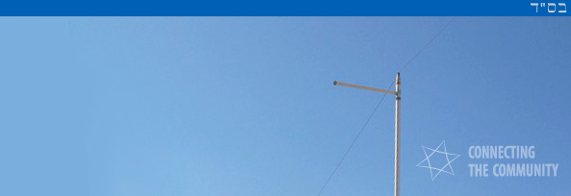
Sydney
Eruv

Slide 5
The Sabbath Day – To be Holy – A Day of Rest
God created for 6 days, and on the 7th day He rested
Resting on the 7th day, was a sign that Israel were God’s people
The Bible doesn’t legislate what is/is not work. Some examples are given.
Ploughing and Harvest
Kindle the home fire (domestic duties?)
Trading (buying/selling)
Transportation of goods
Gathering sticks (for work)

Slide 6
^{Exodus 31: 12} And YHWH said to Moses, ¹³ “You are to speak to the people of Israel and say, ‘Above all you shall keep my Sabbaths, for this is a sign between me and you throughout your generations, that you may know that I, YHWH, sanctify you. ¹⁴ You shall keep the Sabbath, because it is holy for you. Everyone who profanes it shall be put to death. Whoever does any work on it, that soul shall be cut off from among his people. ¹⁵ Six days, shall work be done, but the seventh day is a Sabbath of solemn rest, holy to YHWH. Whoever does any work on the Sabbath day shall be put to death. ¹⁶ Therefore the people of Israel shall keep the Sabbath, observing the Sabbath throughout their generations, as a covenant forever. ¹⁷ It is a sign forever between me and the people of Israel that in six days YHWH made heaven and earth, and on the seventh day he rested and was refreshed.’ ”

Slide 7
The Sabbath Day – To be Holy – A Day of Rest
God created for 6 days, and on the 7th day He rested
Resting on the 7th day, was a sign that Israel were God’s people
The Bible doesn’t legislate what is/is not work. Examples given: (Farming; Labouring; trading; transporting goods; domestic work)
A sign for Israel, that they would know that God sanctifies them.
Where is the line between work & play – vocation & recreation
The old religious legalism needs to legislate and draw a line to not be crossed
The way of the Spirit is a matter of the Heart
1. The Sabbath was made for man – not man for the Sabbath
The law of need & mercy, overrides the law of ceremony
We are designed to rest (1 day in 7), but if it becomes a rule, we miss the point
2. The Son of Man is Lord, even of the Sabbath
The Sabbath was made, for man to rest, but we rest in the Lord of the Sabbath
Jesus gets angry at hard heartedness – when the truth is staring us in the face,
but we refuse to let it move us.

Slide 8
The Sabbath Day – To be Holy – A Day of Rest
God created for 6 days, and on the 7th day He rested
Resting on the 7th day, was a sign that Israel were God’s people
A sign for Israel, that they would know that God sanctifies them.
1. The Sabbath was made for man – not man for the Sabbath
The law of need & mercy, overrides the law of ceremony
We are designed to rest (1 day in 7), but if it becomes a rule, we miss the point
2. The Son of Man is Lord, even of the Sabbath
The Sabbath was made, for man to rest, but we rest in the Lord of the Sabbath
Jesus gets angry at hard heartedness – when the truth is staring us in the face,
but we refuse to let it move us.
The Sabbath Rest, is fulfilled in Jesus Christ
Hebrews 4
The Sabbath looked forward when we would rest from our works-based religion
Don’t harden our hearts against God, but Believe
No religious rule / requirement that Disciples of Jesus must rest on the Sabbath
The death & resurrection of Jesus Christ has done away with the religious rule
Now a heart issue for us to want to keep the day holy; rest; do good; worship

